Slide 1



Slide 2
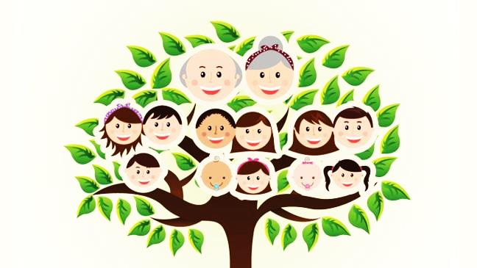
BLOOD RELATIONS

Slide 3
Question 1
J, K, L, M and N went for a trek. J is the son of K, but K is not the father of J. L is the son of M, who is the brother of J. N is the wife of M. How is J related to M?
(a) Nephew
(b) Brother
(c) Father
(d) None of these

Slide 4
Solution
J is the son of K but K is not the father of J means that K must be the mother of J. Also, L is the son of M, who is the brother of J means that M and J must be brothers and L is M’s son. Also, since N is the wife of M, L must be N’s son also. Consolidating these relationships we get:
K mother of M and J (brothers). Also, M’s wife is N and their son is L.
J is M’s brother.
Hence, (b) is correct option.

Slide 5
Question 2
Sam’s father is the only son of James’s father. How is James related to Sam?
(a) Father
(b) Brother
(c) Can’t be determined
(d) None of these

Slide 6
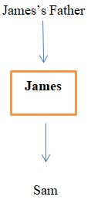
Solution
Sam’s father being the only son of James’s father, means that James must be Sam’s father.
Option (a) is the answer.
(Only son of James’s father should be James)

Slide 7
Question 3
a @ b means a is the daughter of b
a # b means a is the husband of b
a $ b means a is the brother of b
From the above information, if A @ B $ C @ D $ E @ F $ G, then what is the present generation of A? Assume that the oldest generation in this group is the first generation.
2nd (b) 3rd
(c) 4th (d) None of these

Slide 8
Solution
A @ B $ C @ D $ E @ F $ G means A is the daughter of B, B is the brother of C, C is the daughter of D, D is the brother of E, E is the daughter of F and F is the brother of G. Thus, if F and G are the first generation, D and E are the second, B and C are the third generation, A is the fourth generation. To solve this question in short, you only need to realize that the use of the @ sign signifies a generation change. Since the @ sign is used thrice, A must be the fourth generation.
Hence, option (c) is the answer.

Slide 9
Question 4
Andy is the brother of Binoy and Cindy. Daisy is Cindy’s mother. Eliot is Andy’s father. Which of the following statement cannot be definitely true?
Eliot is Binoy’s father
Daisy is Andy’s Mother
Binoy is Eliots’s son
Andy is Daisy’s son

Slide 10
Solution
Gender of B is not there in the question.
Therefore, (c) is the correct option.

Slide 11
Question 5
Pointing to a lady, Harish said, "The son of her only brother is the brother of my wife." How is the lady related to Harish?
Maternal aunt
Grandmother
Sister of father-in-law
None of these

Slide 12
Solution
Brother of Harish's wife → brother-in-law of Harish. Hence, the son of lady's brother is brother-in-law of Harish.
Therefore, the brother of the lady is the father-in-law of Harish.
Hence, the lady is the sister of Harish’s father-in-law.

Slide 13
Question 6 - 7
Directions:
If A  B means A is the brother of B;
A ○ B means A is the sister of B;
A  B means A is the daughter of B;
A  B means A is the son of B;
A  B means A is the father of B;
A  B means A is the mother of B.

Slide 14
Question 6
According to P  Q  R ○ S, how is P related to S?
Mother
Daughter
Aunt
Cannot be determined

Slide 15
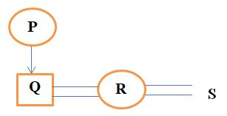
Solution
Hence the answer is (a) mother.

Slide 16
Question 7
Deduce the relationship between E and A if ‘A  B ○ C  D  E’
Brother – Sister
Husband – Wife
Uncle – Aunt
Cannot be determined

Slide 17
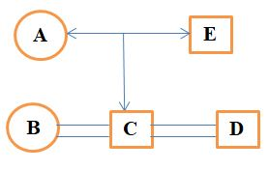
Solution
Hence the answer is (b) Husband – Wife

Slide 18
Question 8
Geetha is the mother-in-law of Seetha who is the sister-in-law of Shyam. Kishore is father of Aditya, the only brother of Shyam. How is Geetha related to Shyam?
Mother-in-law
Aunt
Wife
Mother

Slide 19
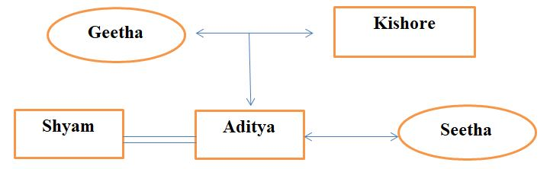
Solution
Hence the answer is (d) Mother

Slide 20
Question 9
Introducing Amit, Priyanshi said, “His brother’s father is the only son of my grandfather”. How is Priyanshirelated to Amit?
Sister
Daughter
Mother
Niece

Slide 21
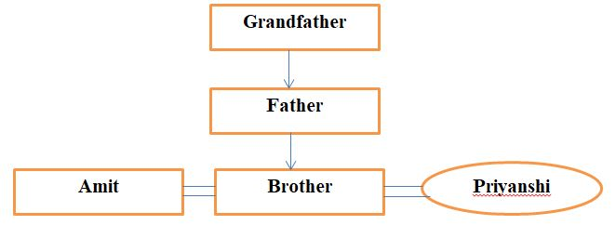
Solution
Hence the answer is (a) Sister

Slide 22
Question 10
If A + B means A is the sister of B, A – B means A is the brother of B, A x B means A is the daughter of B, A & B means A is the mother of B. Which of the following relationship shows that L and N are wife and husband?
L – M x N
L & M x N
L + M x N
None of these

Slide 23
Solution
Go through the options, L & M means L is the mother of M. M x N means M is the daughter of N. Thus, M must be the daughter of L and N.
Hence (b) is the correct option.

Slide 24
Question 11
Ram told Lakshman, “Yesterday, I met the only brother of the daughter of my grandmother.” Whom did Ram meet?
Cousin
Brother
Nephew
Father

Slide 25
Solution
The clue makes the man son of Ram’s grandmother i.e., the man can be Ram’s father or uncle. Since the options do not contain uncle, we have to conclude it is the father.
So (d) is the right option.

Slide 26
Question 12 - 14
Directions: Amitabh has a family of eight members. Prakash is the eldest male member of the family. Radhika is the daughter-in-law of Ramya and sister-in-law of Dhanush and Surya. Apart from Amitabh and Prakash, only Dhanush is a male member in the family. Surya is the aunt of Amitabh’s two daughters Diya and Anu.

Slide 27
Question 12
How is Anu related to Dhanush?
Grandmother
Mother
Niece
Aunt

Slide 28
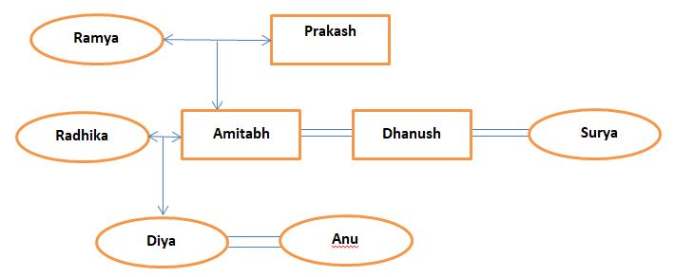
Solution
So, (c) Niece is the correct answer.

Slide 29
Question 13
Find the relation between Radhika and Diya?
Sister-in-law
(b) Aunt – Niece
(c) Grandmother – Granddaughter
(d) Mother – Daughter

Slide 30
Solution
(d) Mother – Daughter is the answer.

Slide 31
Question 14
Who is the husband of Radhika?
Amitabh
Dhanush
Prakash
Cannot be determined

Slide 32
Solution
(a) Amitabh is the correct answer

Slide 33
Question 15
A  B means A is the brother of B; A  B means A is the daughter of B; A  B means A is the sister of B. If A  B  C  D  E  F  G, then how many males and females are there respectively?
4, 3 (b) 3, 4
(c) 5, 2 (d) Cannot be determined

Slide 34
Solution
Here, G’s sex is indeterminable. Hence, the answer cannot be determined.
Option (d) is the answer.

